Slide 1

Analysis of Comcast Telecom Consumer Complaints

Slide 2
Outline
Business Scenario
Objectives
Analysis Tasks
Number of complaints
Frequency of complaint types
Maximum complaint types
Highest percentage of unresolved complaints by state
State wise status of complaints
Percentage of complaints resolved

Slide 3

Business Scenario
Comcast is an American global telecommunication company. The firm has been providing terrible customer service. They continue to fall short despite repeated promises to improve. Only last month (October 2016) the authority fined them a $2.3 million, after receiving over 1000 consumer complaints. The existing database will serve as a repository of public customer complaints filed against Comcast. It will help to pin down what is wrong with Comcast's customer service.

Slide 4
Objectives
Provide the trend chart for the number of complaints at monthly and daily granularity levels.
Provide a table with the frequency of complaint types.
Which complaint types are maximum?
Provide state wise status of complaints in a stacked bar chart.
Which state has the maximum complaints?
Which state has the highest percentage of unresolved complaints?
Provide the percentage of complaints resolved till date, which were received through the Internet and customer care calls.

Slide 5

Analysis tasks

Slide 6
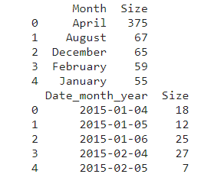
The table shows the frequency distribution of complaints by month and date.

Slide 7
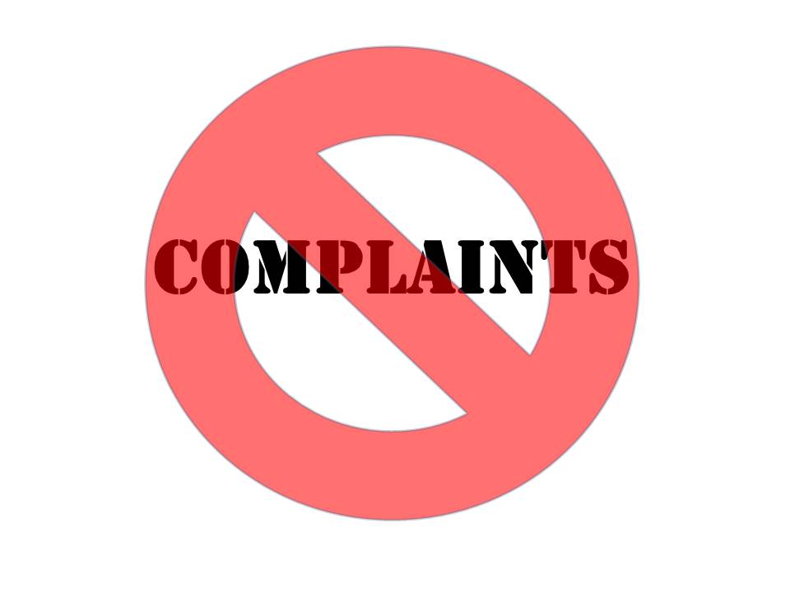
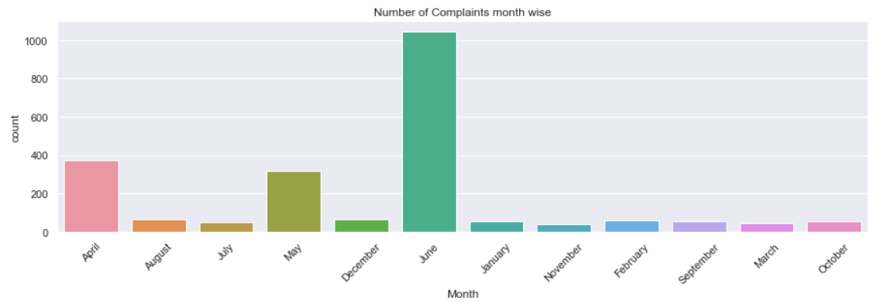
The chart below shows the number of complaints at a monthly granularity level. The bar chart depicts that June has the most complaints. The months of April and May suggest that a significant number of complaints were filed in those months. The other months show a range of consistency with the average number of complaints issued.

Slide 8
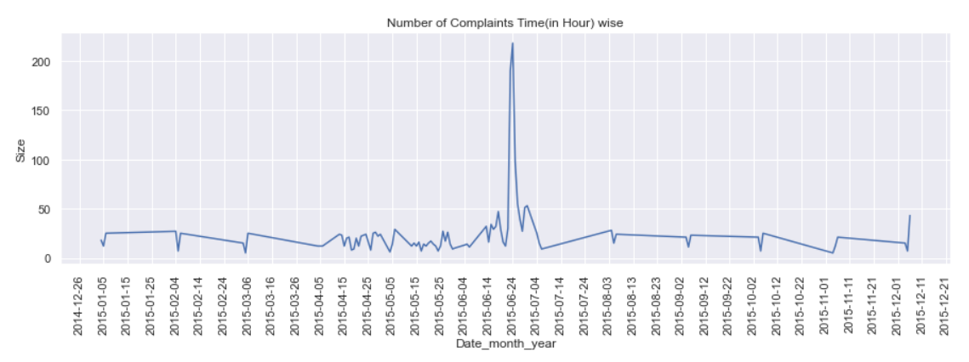
The charts show the number of complaints at daily granularity levels. This line graph shows a significantly high peak on June 24th 2015.

Slide 9
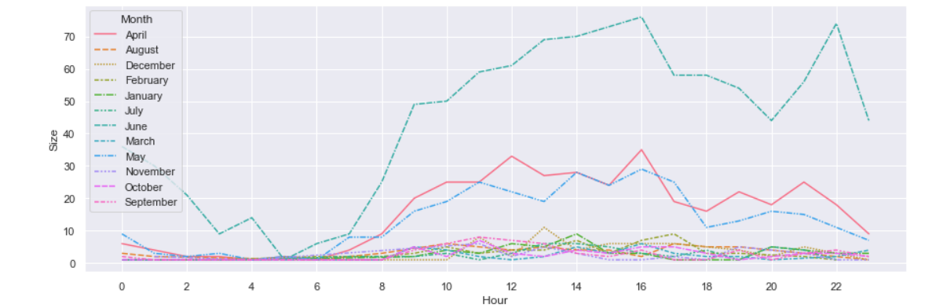
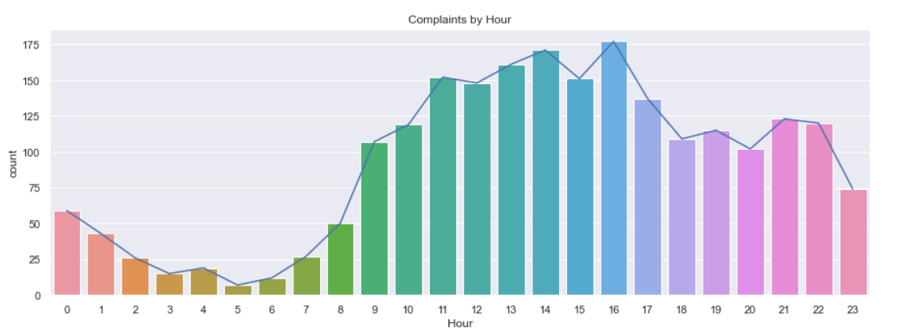
The line graph and bar charts show a visual representation of complaints by hour with respect to size and count.

Slide 10
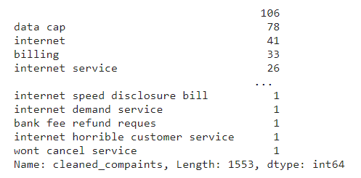
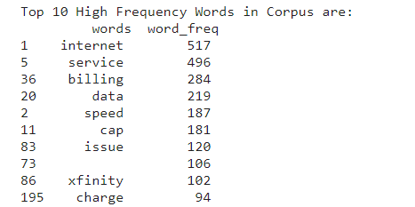
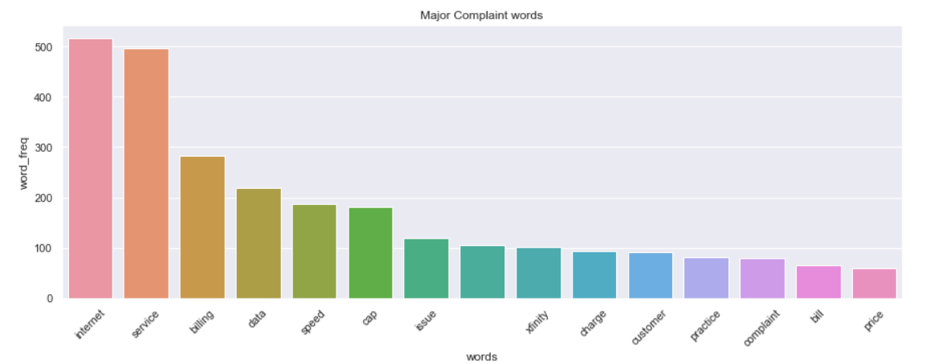
Clearly complaints regarding internet services have the greatest share. Billing is also another high frequency word used in the complaints.

Slide 11
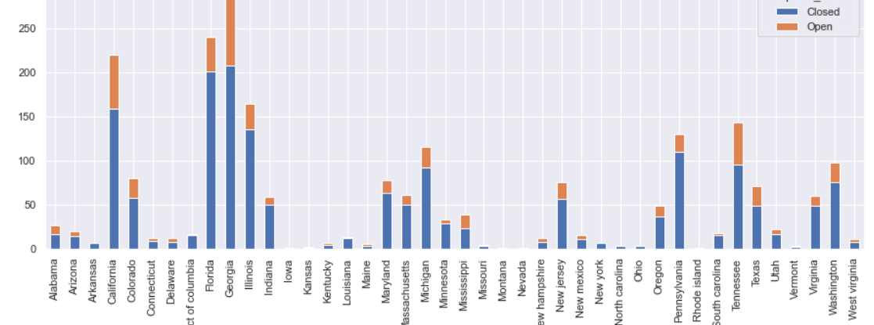
Georgia has the highest number of complaints, whereas Tennessee seems to have the highest percentage of complaints.

Slide 12
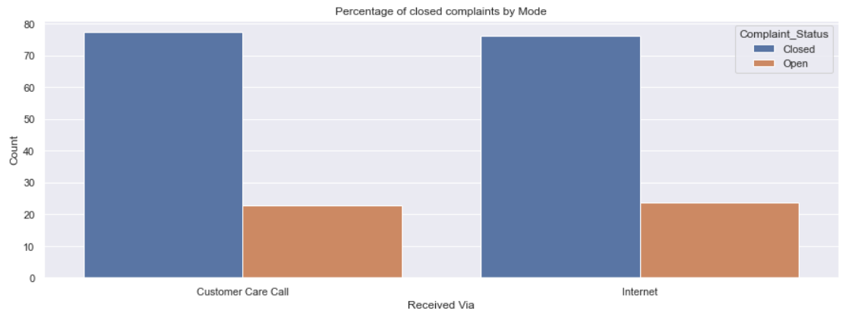
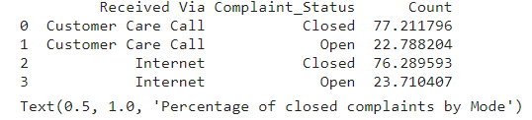
Majority of the complaints whether via customer care call or internet were closed at a rate of approximately 77%. Approximately 23% of customer care calls remain open while 24% of internet complaints remain open.

